Slide 1
FU TIMETABLING

Slide 2
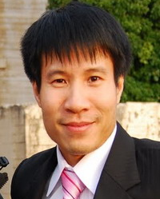
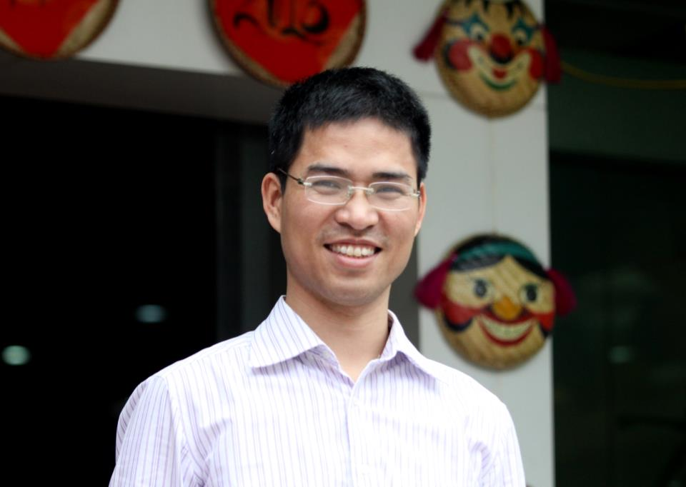
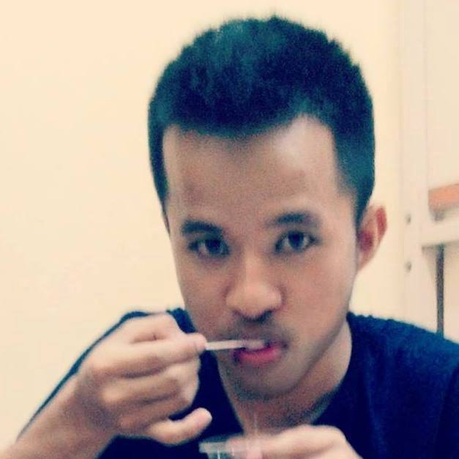
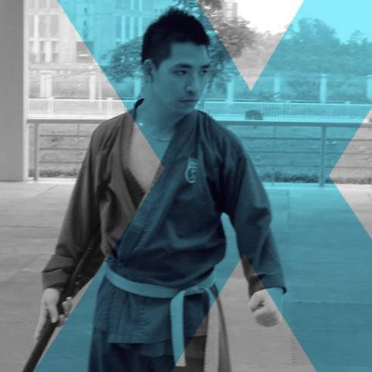
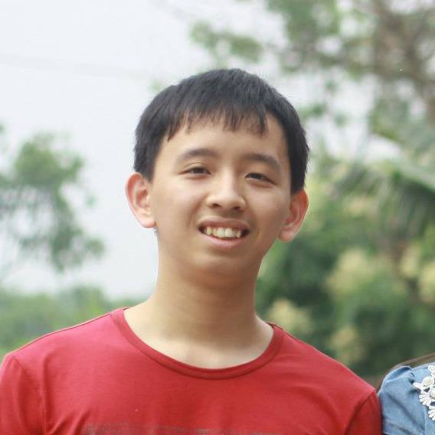
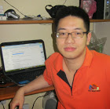
TEAM MEMBERS
SUPERVISORS
Mr. DungPQ
Mr. TrungNT
Team

Slide 4
OVERVIEW
SUN | MON | TUE | WED | THU | FRI | SAT

Slide 5
FU’s Current

Slide 6










TECHNOLOGIES
SPRING
MySQL 5.6
FXML
SPRING DATA
LOG4J
Choco
Tomcat
Hibernate
POI
Open-cbls

